Slide 1
CS 518 Web Programming
Sai Siva Saketh K
Hariharan T

Slide 2
Welcome to the new Bazaar in the “town”
Our idea is to have a social networking website which is more like Facebook and Instagram but more focused on ecommerce features.
It will have an added feature to view, buy, sell and rent any items that ever exists.

Slide 3
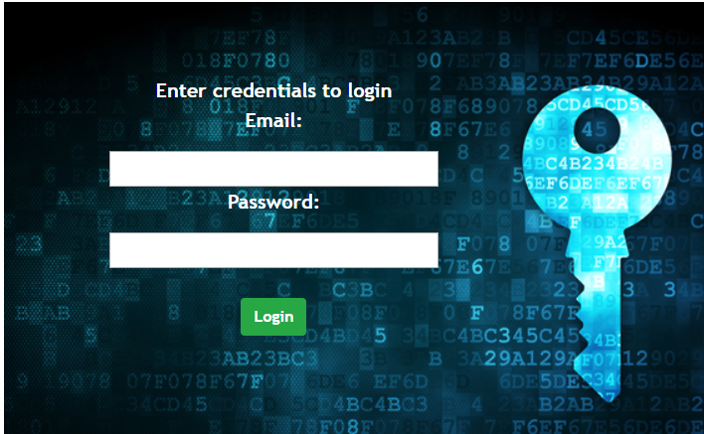
Where are we on it ??

Slide 4
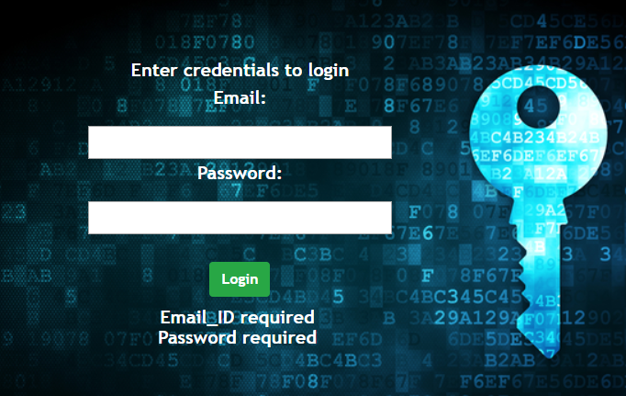
Form Validations – No email or password?

Slide 5
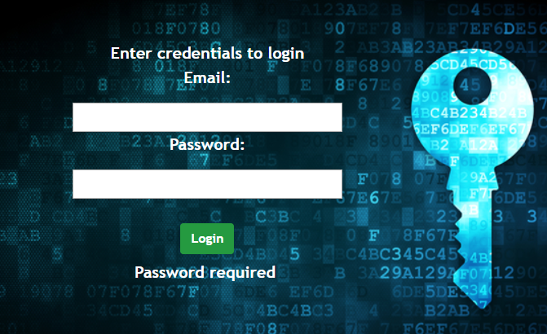
No Password? We check that too

Slide 6
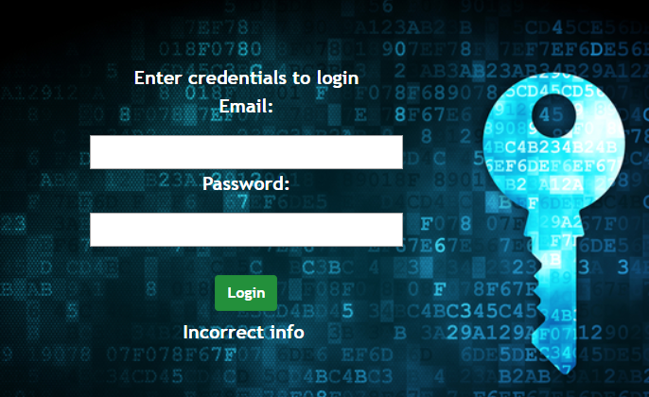
Incorrect info? No excuse

Slide 7
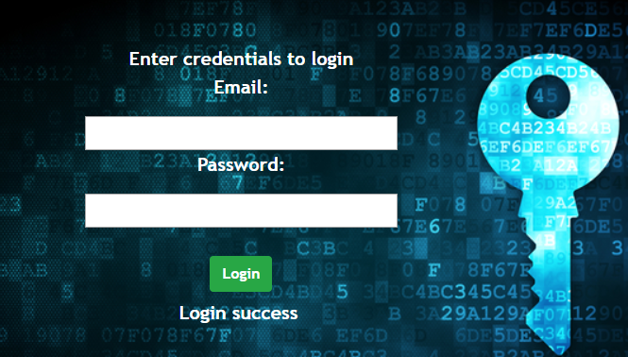
You’re good to go

Slide 8
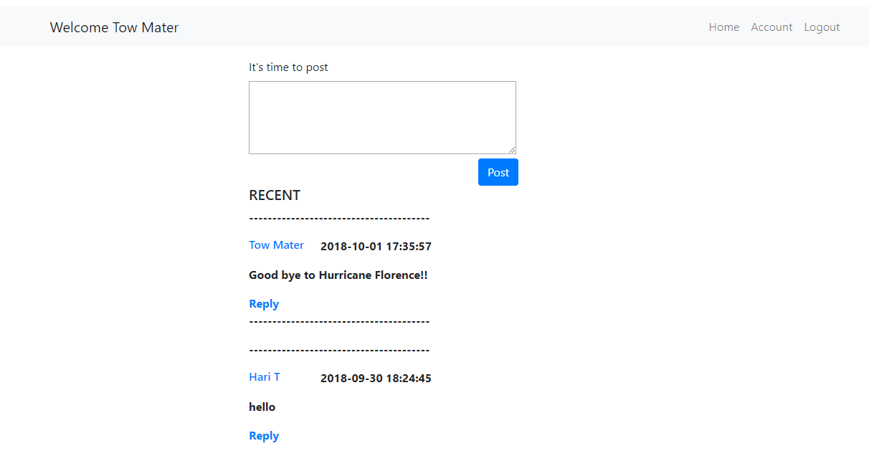
Want to Post something? We highly encourage you

Slide 9
Future plans?
To complete other milestones
Creating user groups
Replies to posts
Formatting the website better
Links to groups in homepage

Slide 10
Thank you

